Slide 1
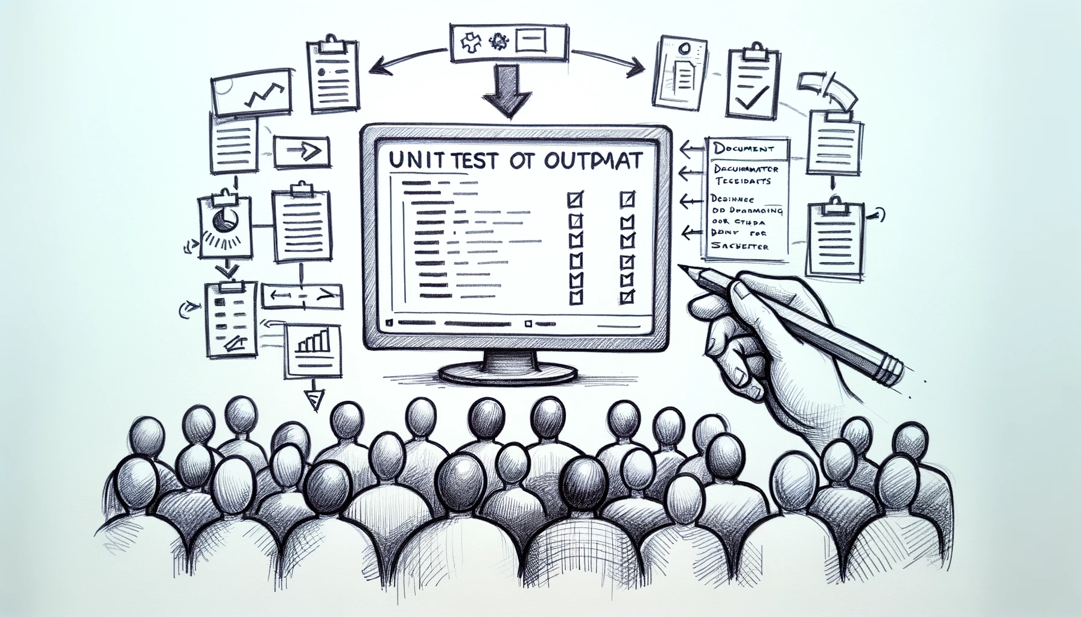
Better Testing with Approvals
Better Testing with ApprovalTests
Llewellyn Falco
Lada Kesseler
Llewellyn Falco
Lada Kesseler

Slide 2
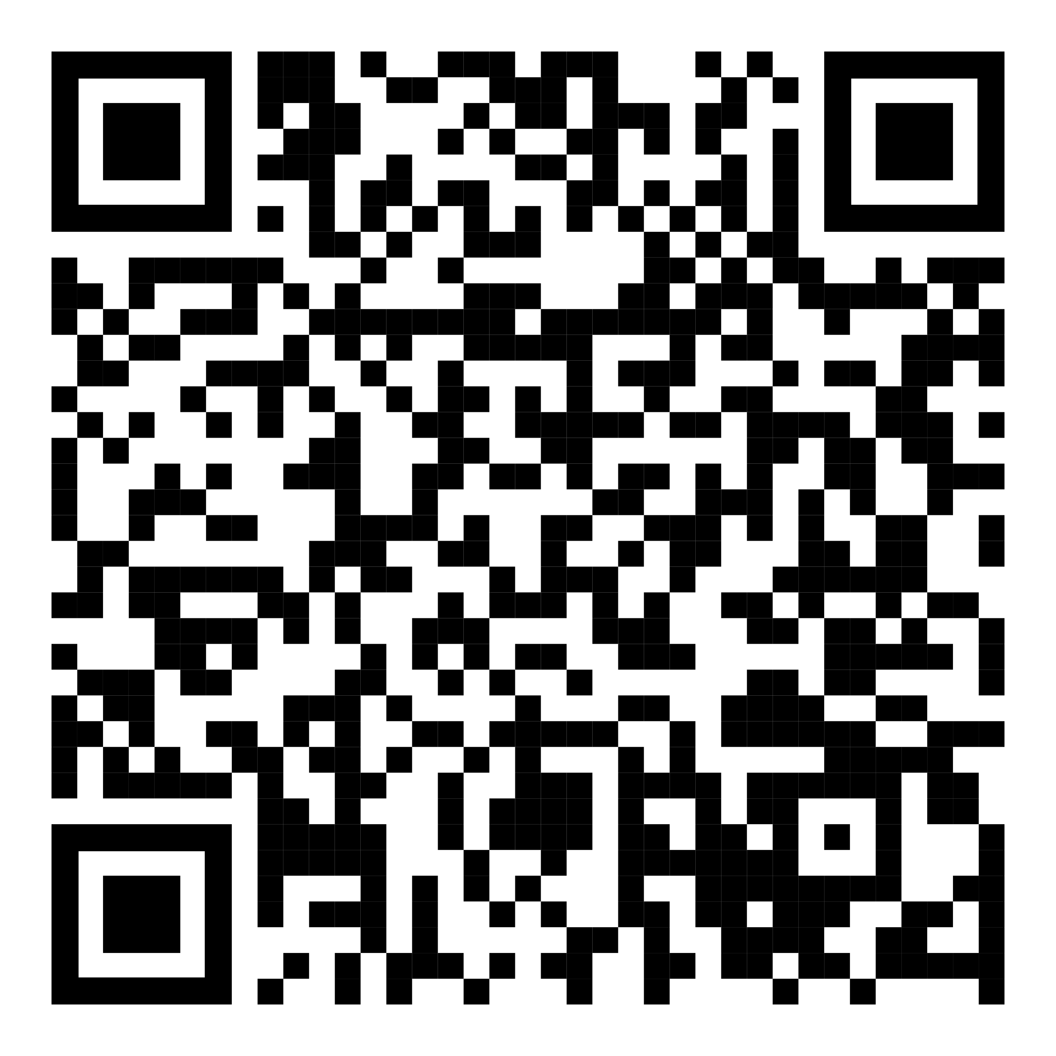
Resources
Notes:
https://github.com/isidore/Talks/blob/master/BetterTestingWithApprovals.md

Slide 3
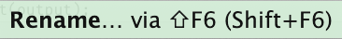
Housekeeping:
Presentation assistant

Slide 4

..
..
Clear
Expressive
Simple

Slide 5

In the beginning...

Slide 6
code

Slide 7
Problem:
What the test does is confusing

Slide 8
New Concept #1:
Testing Circle

Slide 9
// Create side (0,0) – (3,4)
// Verify length
Whiteboard
English
Testing Circle
Result
Code
Side (0,0) – (3,4) length = 5
Side s = new Side(0,0,3,4);
Approvals.Verify(s + “ length = “ +s.Length);

Slide 10
Chat
[Customer]
hi
[Bot]
Hi there! I'm your virtual assistant.
What would you like to do today?
Notes:
we put the focus on what it is that we're testing, and not the setup of the test

Slide 11
Chat
[Customer]
hi
[Bot]
Hi there! I'm your virtual assistant.
What would you like to do today?
Whiteboard
English
Testing Circle
Result
Code

Slide 12
Chat
[Customer]
hi
[Bot]
Hi there! I'm your virtual assistant.
What would you like to do today?
// customer says ‘hi’
// verify conversation
Whiteboard
English
Testing Circle
Result
Code

Slide 13
Chat
[Customer]
hi
[Bot]
Hi there! I'm your virtual assistant.
What would you like to do today?
// customer says ‘hi’
// verify conversation
Whiteboard
English
Testing Circle
Result
Code
String userMessage = "hi"; verifyConversation(userMessage);

Slide 14
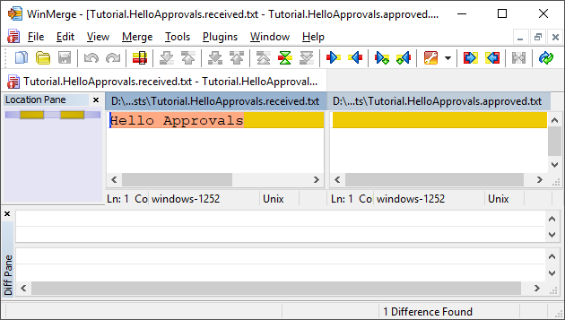
New Concept #2:
Approval Tests
Test + approved output

Slide 15
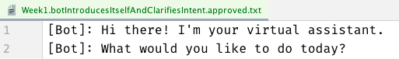
Chat
[Customer]
hi
[Bot]
Hi there! I'm your virtual assistant.
What would you like to do today?
// customer says ‘hi’
// verify conversation
Whiteboard
English
Testing Circle
Result
Code
String userMessage = "hi"; verifyConversation(userMessage);

Slide 16
Chat
[Customer]
hi
[Bot]
Hi there! I'm your virtual assistant.
What would you like to do today?
// customer says ‘hi’
// verify conversation
Whiteboard
English
Testing Circle
Result
Code
[Customer]: hi
String userMessage = "hi"; verifyConversation(userMessage);

Slide 17
Week 1
What happened
Notes:
Pay attention to the testing circle
Create convenience functions to hide unnecessary details

Slide 18
Complex
Tests
ApprovalTests
Testing Circle

Slide 19
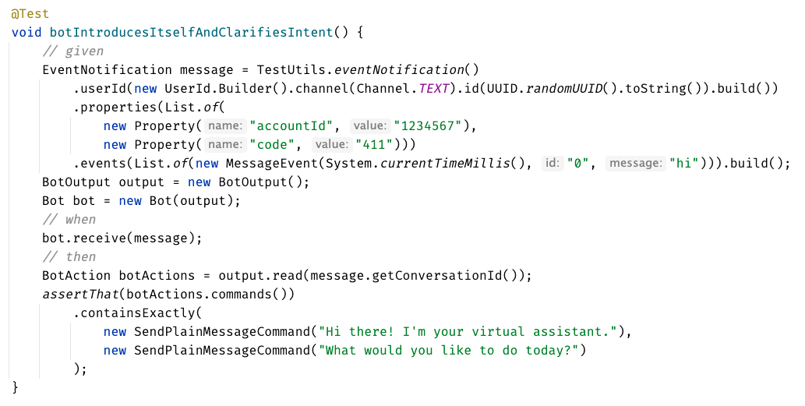

Slide 20
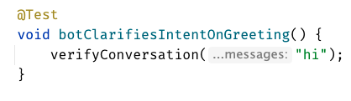
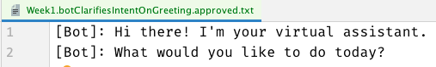

Slide 22
Week 1
learnings
Convenience Functions
ApprovalTests
Testing Circle
verifyConversation("hi");
Notes:
Pay attention to the testing circle
Create convenience functions to hide unnecessary details

Slide 23
...later next week...

Slide 24
code

Slide 25
Problem:
Lack of clarity in the test code output

Slide 26
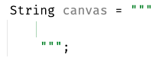
New Concept #3:
Story Board

Slide 27
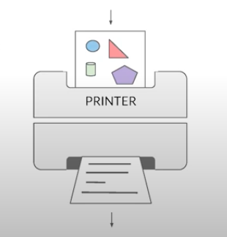
New Concept #4:
Printers
@EmillyBache

Slide 28
Chat
[Customer]
hi
[Bot]
Hi there! I'm your virtual assistant.
What would you like to do today?
[Customer]
pay bill
[Bot]
Are you a customer?
Yes, I'm a customer No, I'm not

Slide 29
[Customer]: hi [ Bot]: Hi there! I'm your virtual assistant. [ Bot]: What would you like to do today? [Customer]: pay bill [ Bot]: Let me try to help you. [ Bot]: { "content": { "type": "vertical", "elements": [ { "type": "text", "text": "Are you a customer?", "tooltip": "text tooltip" }, { "type": "horizontal", "elements": [ { "type": "button", "title": "Yes", "click": { "actions": [ { "type": "publishText", "text": "Yes, I'm a customer" } ] } }, { "type": "button", "title": "No", "click": { "actions": [ { "type": "publishText", "text": "No, I'm not" } ] } } ] } ] } }
Chat
[Customer]
hi
[Bot]
Hi there! I'm your virtual assistant.
What would you like to do today?
[Customer]
pay bill
[Bot]
Are you a customer?
Yes, I'm a customer No, I'm not

Slide 30
Week 2
What happened
Notes:
Pay attention to the testing circle
Create convenience functions to hide unnecessary details

Slide 31

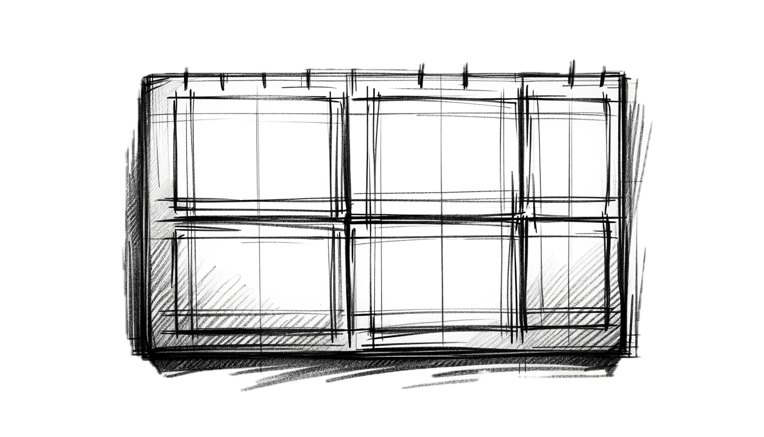
Complex
Tests
ApprovalTests
Testing Circle
Printers
+ Storyboard
JSON

Slide 32
Formatting
[Customer]: hi [Bot]: Hi there! I'm your virtual assistant. [Bot]: What would you like to do today?
[Customer]: hi [ Bot]: Hi there! I'm your virtual assistant. [ Bot]: What would you like to do today?

Slide 33
Formatting
[Customer]: hi [Bot]: Hi there! I'm your virtual assistant. [Bot]: What would you like to do today? [Customer]: hi [Bot]: Hmmm, tell me a little more so I can help you. What would you like to do today? [Customer]: hi [Bot]: Let me try to help you. [Bot]: Are you a customer? 1) Yes, I'm a customer 2) No, I'm not
[Customer]: hi
[ Bot]: Hi there! I'm your virtual assistant. [ Bot]: What would you like to do today? [Customer]: hi [ Bot]: Hmmm, tell me a little more so I can help you. [ ]: What would you like to do today? [Customer]: hi [ Bot]: Let me try to help you. [ Bot]: Are you a customer? [ ]: 1) Yes, I'm a customer [ ]: 2) No, I'm not

Slide 34
[Customer]: hi [ Bot]: Hi there! I'm your virtual assistant. [ Bot]: What would you like to do today? [Customer]: pay bill [ Bot]: Let me try to help you. [ Bot]: { "content": { "type": "vertical", "elements": [ { "type": "text", "text": "Are you a customer?", "tooltip": "text tooltip" }, { "type": "horizontal", "elements": [ { "type": "button", "title": "Yes", "click": { "actions": [ { "type": "publishText", "text": "Yes, I'm a customer" } ] } }, { "type": "button", "title": "No", "click": { "actions": [ { "type": "publishText", "text": "No, I'm not" } ] } } ] } ] } }
[Customer]: hi [ Bot]: Hi there! I'm your virtual assistant. [ Bot]: What would you like to do today? [Customer]: pay bill [ Bot]: Let me try to help you. [ Bot]: Are you a customer? [ ]: 1) Yes, I'm a customer [ ]: 2) No, I'm not

Slide 35
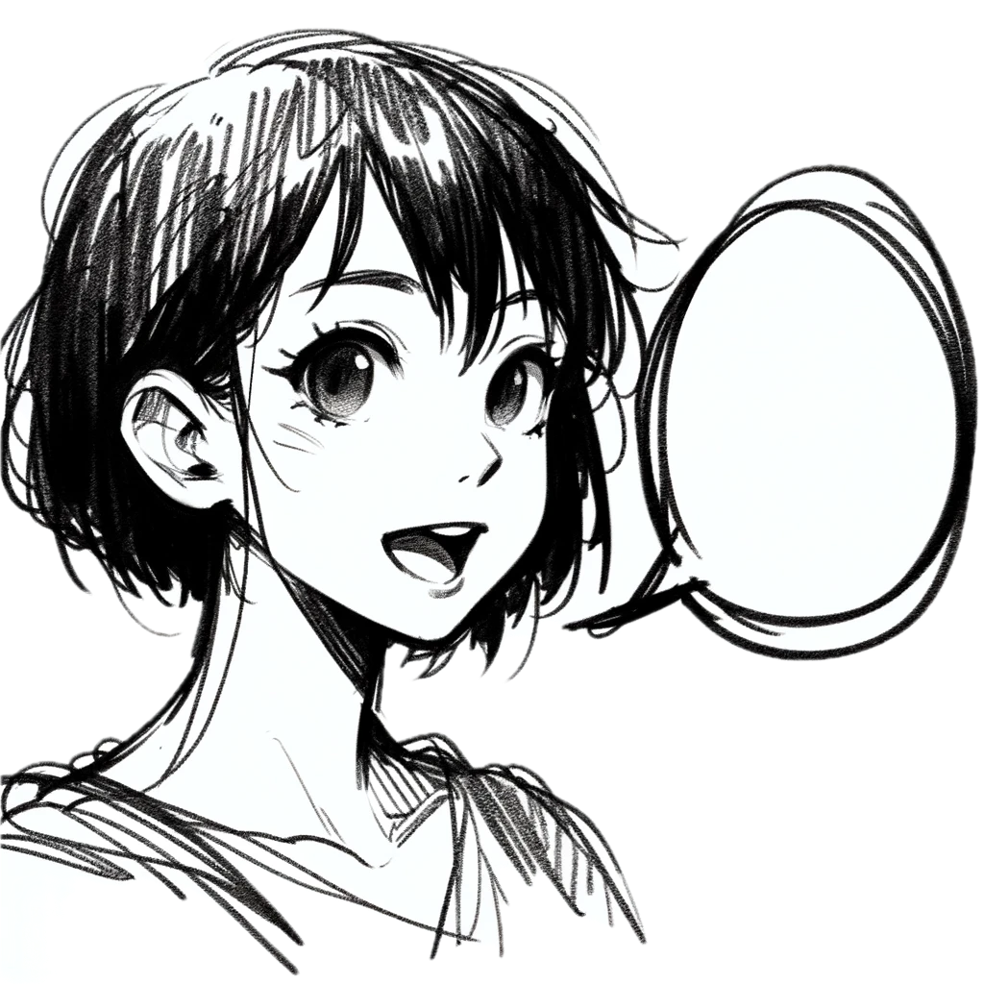
Week 2
learnings
Storytelling
Storyboard
Printers
Formatting
[Customer]: talk to an operator [ Bot]: Hi there! I'm your virtual assistant. [ Bot]: Let me try to help you. [ Bot]: Are you a customer? [ ]: 1) Yes, I'm a customer [ ]: 2) No, I'm not
Notes:
Pay attention to the testing circle
Create convenience functions to hide unnecessary details

Slide 36
...later next week...

Slide 37
code

Slide 38
Problem:
Too many .approved. files

Slide 39
New Concept #5:
Inline Approvals

Slide 40
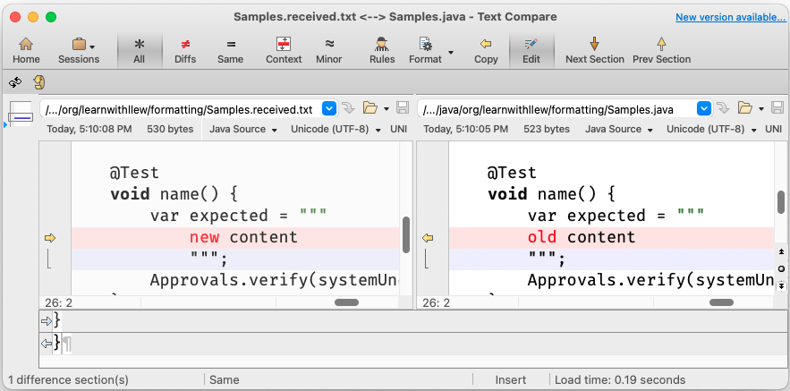
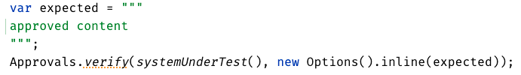
New Concept:
Inline Approvals
“Look mom, no files!”
Possible new source file
Original source file
Approved output
How to invoke
Pressing this modifies
your source code

Slide 41
Week 3
What happened
Notes:
Pay attention to the testing circle
Create convenience functions to hide unnecessary details

Slide 42
Complex
Tests
ApprovalTests
Testing Circle
Printers
+ Storyboard
JSON
Inline

Slide 43
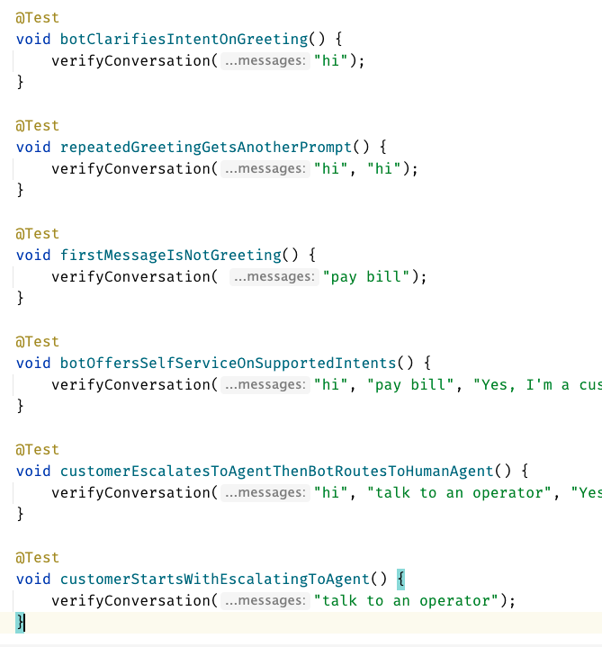
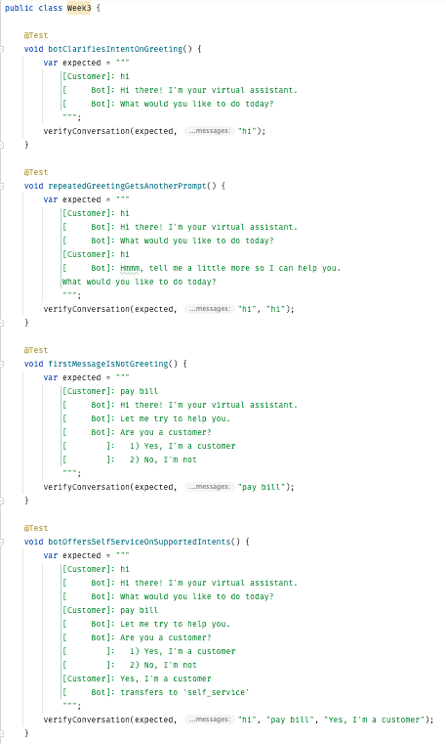
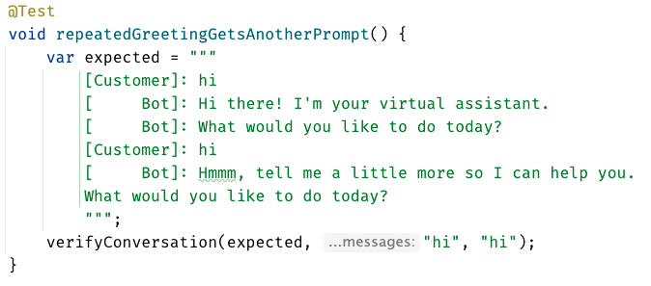
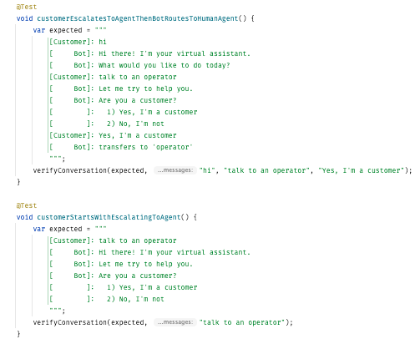
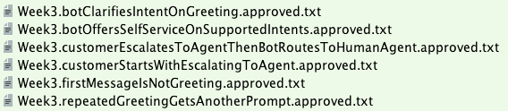

Slide 44
Week 3
learnings
Inline
Notes:
Pay attention to the testing circle
Create convenience functions to hide unnecessary details

Slide 45
...later next week...

Slide 46
code
Notes:
Hey Llewellyn, look what I did

Slide 47
Problem:
Can’t see the overall test strategy
hard to see if you’re missing cases...

Slide 48
New Concept #6:
verifyAll()

Slide 49
New Concept #7:
many of one

Slide 50
Week 4
What happened
Notes:
Pay attention to the testing circle
Create convenience functions to hide unnecessary details

Slide 51
Complex
Tests
ApprovalTests
Testing Circle
Printers
+ Storyboard
JSON
Verify all
Inline

Slide 52
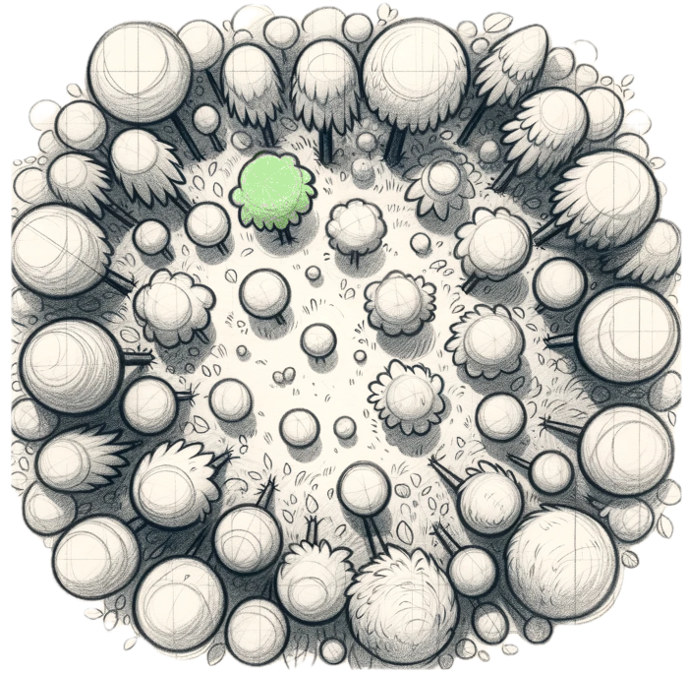
Week 4
learnings
Verify all
Printers
See the forest AND the trees
Notes:
Pay attention to the testing circle
Create convenience functions to hide unnecessary details

Slide 53
...later next week...

Slide 54
code
Notes:
Hey Llewellyn, look what I did

Slide 55
Problem:
95% of tests are together
but 5% are alone...

Slide 56
New Concept #8:
Custom test scenario builders
creating Domain-Specific Language (DSLs)

Slide 57
Week 5
What happened
Notes:
Pay attention to the testing circle
Create convenience functions to hide unnecessary details

Slide 58
Complex
Tests
ApprovalTests
Testing Circle
Printers
+ Storyboard
JSON
Verify all
Inline
domain DSL

Slide 59
var conversation1 = conversation("pay bill", "Yes, I'm a customer"); var conversation2 = conversation("pay bill"); var conversations = List.of(conversation1, conversation2);
conversation("pay bill", "No, I'm not") .thenConversation("pay bill")

Slide 60
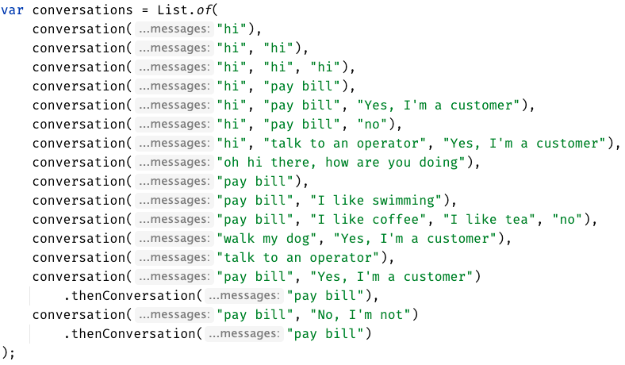

Slide 61
Week 5
learnings
See the forest AND the trees
(consistency)
Domain DSL
Notes:
Invest in APIs that make it easier to express test scenarios

Slide 62
...later next week...

Slide 63
code
Notes:
Hey Llewellyn, look what I did

Slide 64
Problem:
The tests are only for developers

Slide 65
New Concept #9:
Alternative .approved. files
new Options().forFile().withExtension(".md")
Notes:
stakeholders

Slide 66
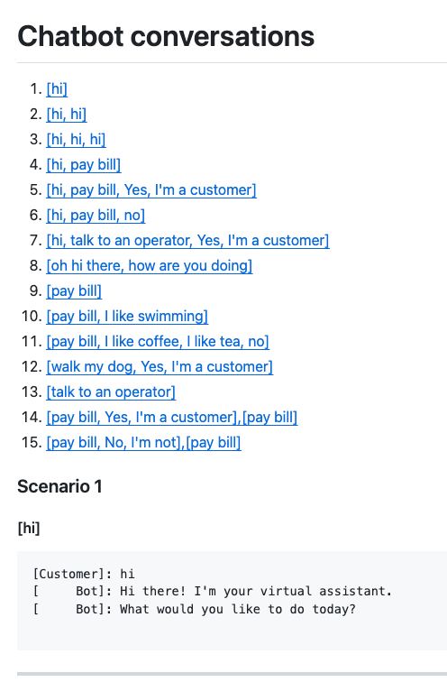
Complex
Tests
ApprovalTests
Testing Circle
Printers
+ Storyboard
markdown
Tests
work as Documentation
JSON
Verify all
Inline
domain DSL

Slide 67
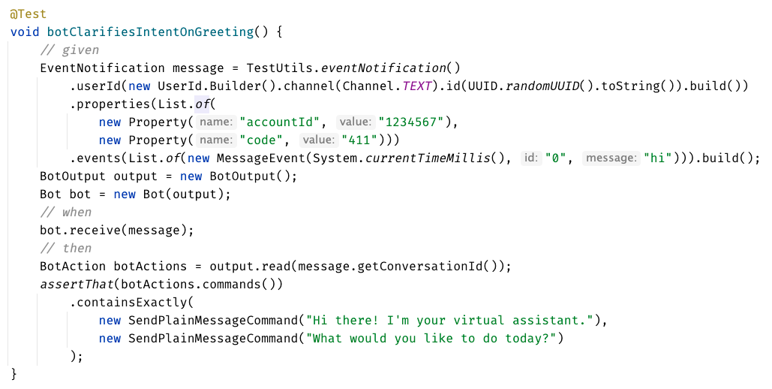
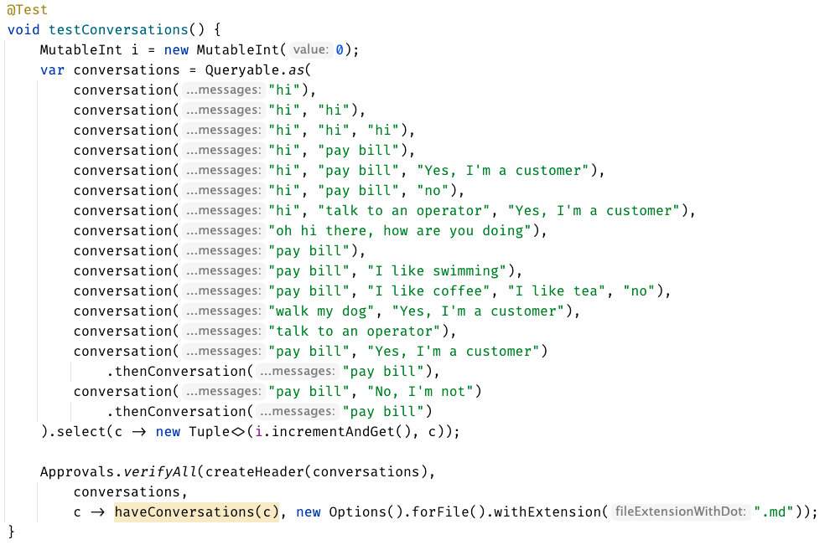

Slide 68
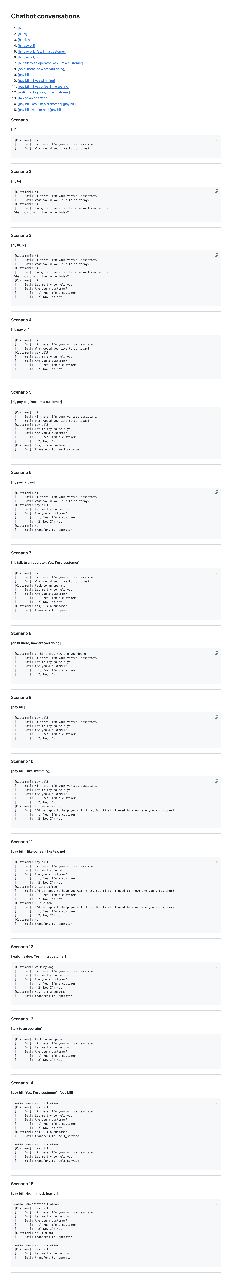

Slide 71
Concepts:
1. Testing Circle
2. Approval Tests
3. Story Board
4. Printers
5. Inline Approvals
6. verifyAll()
7. Many of one
8. Custom test scenario builders (DSL)
9. Alternative .approved. files (markdown)

Slide 72
learnings
Storyboard
ApprovalTests
Storytelling
Testing Circle
Printers
Inline
Convenience Functions
verifyConversation("hi");
Domain DSL
See the forest AND the trees
Verify all
markdown
Notes:
Pay attention to the testing circle
Create convenience functions to hide unnecessary details

Slide 73
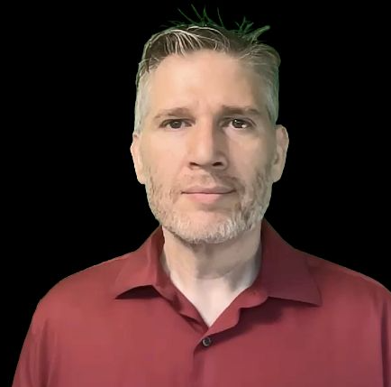
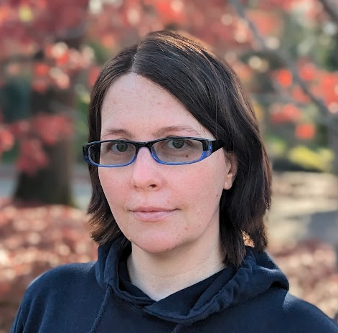
Resources
Thank you!
Llewellyn Falco
Lada Kesseler
Please connect on LinkedIn
Notes:
https://github.com/isidore/Talks/blob/master/BetterTestingWithApprovals.md

Slide 74
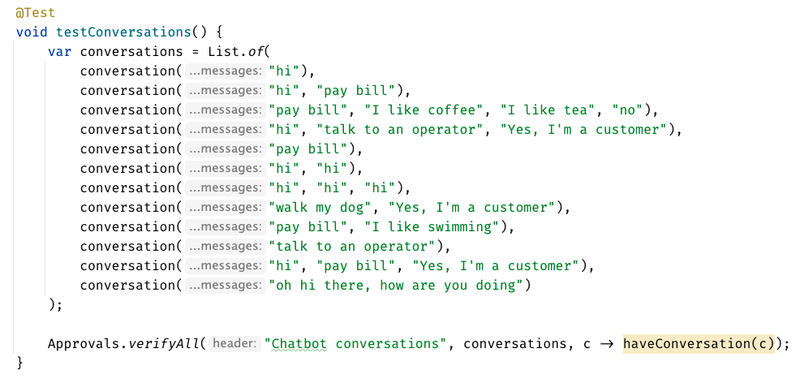

Slide 75
Chat
[Customer]
hi
[Bot]
Hi there! I'm your virtual assistant.
What would you like to do today?
Whiteboard
English
Testing Circle
Result
Code

Slide 76
Test.approved.txt
[Bot]: Hi there! I'm your virtual assistant. [Bot]: What would you like to do today?
Test.approved.txt
[Customer]: hi
[ Bot]: Hi there! I'm your virtual assistant. [ Bot]: What would you like to do today?

Slide 77
var expected = """ [Customer]: hi [ Bot]: Hi there! I'm your virtual assistant. [ Bot]: What would you like to do today? """; verifyConversations(expected, "hi");

Slide 78
var conversations = List.of( conversation("hi"), conversation("hi", "hi"), conversation("hi", "hi", "hi"), conversation("hi", "pay bill"), conversation("hi", "pay bill", "Yes, I'm a customer"), conversation("hi", "pay bill", "no"), conversation("hi", "talk to an operator", "Yes, I'm a customer"), conversation("oh hi there, how are you doing"), conversation("pay bill"), conversation("pay bill", "I like swimming"), conversation("pay bill", "I like coffee", "I like tea", "no"), conversation("walk my dog", "Yes, I'm a customer"), conversation("talk to an operator") );
conversation("pay bill", "No, I'm not") .thenConversation("pay bill")

